Slide 1
Logging and
Gary Johnson, NA6O

Slide 2
Agenda
What is logging and why do it?
Logging by hand
Computer logging
Online databases
ARRL’s Logbook of the World
Installing and using TQSL

Slide 3
What is Logging and why do I care?
Your log is a record of each contact (QSO)
Call sign, date, time, band, mode….
FCC used to require that all transmissions be logged. Your logbook was a legal document!
Now, it’s like a radio diary, and also commonly for award tracking

Slide 4
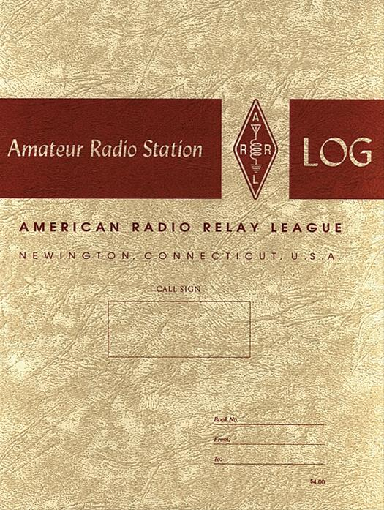
Paper logs are still fun and useful to keep
No restriction on what you can write down
No computer to crash or go obsolete
Life is simple

Slide 5
Computer logging changed everything
Logging software uses a database to keep track of everything
Fast and efficient
Automated lookup of call sign information
Links to other applications, e.g., for digital communication like FT8
Award tracking
… and much more

Slide 6
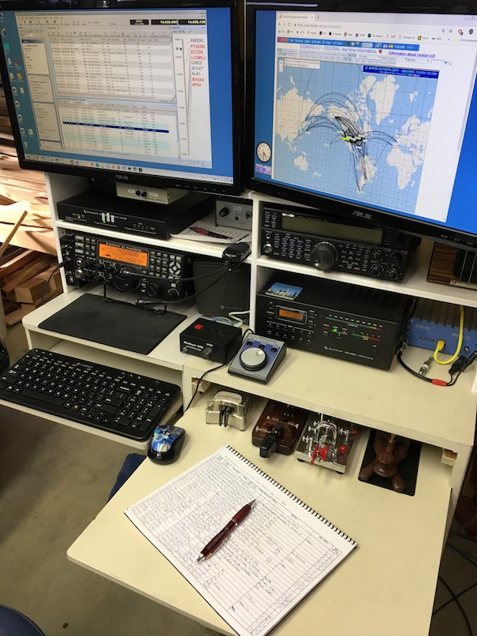
Computer log book
Log book

Slide 7
Logging software comes in all shapes and sizes
For ALL platforms, including smart phones
Optimized for casual use, or contesting
Many are free, some have a modest fee

Slide 8
The feature list for these programs is extensive
Rig control
Station automation
Logging (local plus links to web services)
DX spotting
Rotator control
Satellite tracking
Digital modes (RTTY, JTx, FT8, etc. etc.)
… and more!

Slide 9
Some logging software applications
Casual use
DX Keeper
Logger32
Ham Radio Deluxe
Log4OM
N3FJP
MacLogger DX*
… and many more
Contesting
N1MM+
WriteLog
WinTest
Skookum*
N3FJP
* MacOS

Slide 10
Then there is the world of online logging
Upload your station log to databases on the internet
Electronically confirm contacts = QSL
An alternative to paper QSL cards
Example services:
eQSL
Logbook of the World
Let’s talk about LoTW

Slide 12
What is Logbook of The World?
ARRL's Logbook of the World (LoTW) system is a repository of log records submitted by users from around the world.

Slide 13
What is Logbook of The World?
When both participants in a QSO submit matching QSO records to LoTW, the result is a QSL that can be used for ARRL award credit.

Slide 14
Is LoTW Secure?
To minimize the chance of fraudulent submissions to LoTW, all QSO records must be digitally signed using a digital certificate obtained from ARRL.

Slide 15
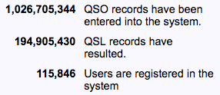
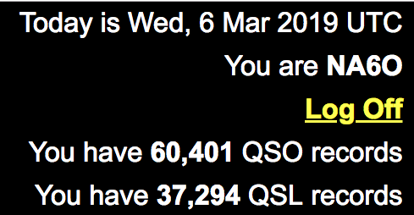
Is LoTW Popular?
1 billion QSOs
4% of all hams
worldwide
My log:
62% confirmed

Slide 16
How much does it cost?
Logbook of The World is FREE to all radio amateurs around the world.
Membership in ARRL is not required.
Users may upload logs and view data anytime with no charges or fees.

Slide 17
What About Award Fees?
When applying for awards users pay the appropriate application fees and QSO fees.
This is no different than when making a paper application for an award.

Slide 18
What About QSL Cards?
LoTW does not replace QSL collecting.
ARRL QSL Bureau is still a member benefit.

Slide 19
What About QSL Cards?
LoTW saves money and time
–No postage or IRCs
–No QSL card printing expense
–No waiting for QSL cards

Slide 20
How is LoTW different than other online QSL services?
Because LoTW uses private key and public key technology, users are verified and data uploaded to the system is secure.
LoTW is constantly comparing uploaded data for matches.
There are no paper cards printed that have the potential to be altered.

Slide 21
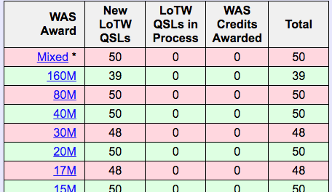
What can I do with LoTW?
Apply for awards
Track award credits
Search QSOs and QSLs
View QSL Details
Awards currently supported:
WAS, DXCC, VUCC, CQ-WPX, CQ-WAZ

Slide 22
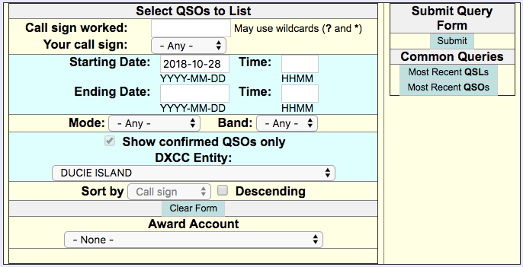
What can I do with LoTW?
Search QSOs and QSLs (Your logging software can also do this)

Slide 23
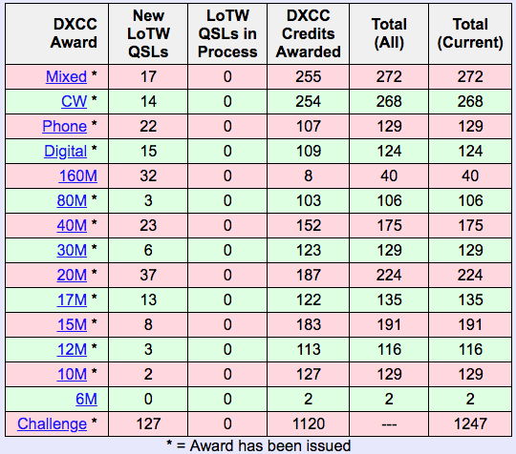
What can I do with LoTW?
Track DXCC (or WAS or...) progress

Slide 24
What can I do with LoTW?
Apply for awards
You can also submit paper QSLs to supplement LoTW confirmed QSOs
Small charge per QSO, and for certificates etc. Online payment by credit card

Slide 25
What about software?
LoTW uses software called TQSL. TQSL is free to download and use.
TQSL works with:
MS Windows
Mac OS X
Linux

Slide 26
All About TQSL Software
TQSL is the software that Logbook of The World users install at their location to securely upload logs to Logbook of The World.
TQSL is free to download and use.
www.arrl.org/TQSL-Download

Slide 27
Brief summary of the setup process
1. Download and install TQSL
2. Request new call sign certificate
3. Wait for a postcard from ARRL
4. Download and install your certificate
And you’re ready to use LoTW

Slide 28
Download and install TQSL, then...
The next step is to request a New Call Sign Certificate

Slide 29
Wait a minute...
Why do I need TQSL software?
What is a Call Sign Certificate?
Why do I need this to send my logs to LoTW?

Slide 30
TQSL
Logbook of The World only accepts Trusted files.
Trusted files are created by TQSL.
TQSL uses the Call Sign Certificate to electronically sign the Trusted file.

Slide 31
Types of trusted files
TQ 5 - Request for a Call Sign Certificate.
TQ 6 – Response to a TQ5 request.
TQ 8 – Signed log file.

Slide 32
Requesting a new call sign certificate
This step will generate a TQ5 file

Slide 33
Requesting a new call sign certificate
This is nothing more than filling out a form. Name, address, call sign, e-mail…
Your e-mail
is VERY IMPORTANT!

Slide 34
Requesting a new call sign certificate
The TQSL program will offer to upload your TQ5 request to LoTW. Say Yes.

Slide 35
Requesting a new call sign certificate
After your request (TQ5) is processed at ARRL you will receive your response (TQ6).
Accepting your TQ6 file is a simple mouse click.

Slide 36
The mystical postcard
Why do I hear about receiving a postcard in the mail?

Slide 37
The mystical postcard
When you request a Call Sign Certificate you are requesting a key.

Slide 38
The mystical postcard
The request must be authenticated before sending the key.

Slide 39
The mystical postcard
Authentication is only required when you are creating a new Logbook of The World user account.
For most of us, that means once and only once

Slide 40
The mystical postcard
You will receive a postcard mailed to your address listed in the FCC database.
So be sure your address is correct in ULS

Slide 41
When you get your postcard...
Go to the LoTW web page and enter an eight digit code from the postcard after which the TQ6 file will be e-mailed to you
As I said, e-mail is very important!

Slide 42
One other important thing...
Because the TQ5 and TQ6 are a matched set the request and acceptance must be performed from the same computer.
KISS: Do all of this on your LOGGING computer

Slide 43
Finally you have your TQ6 response
The email arrives.
You click on the TQ6 link.
It launches TQSL and installs itself.
At last, you have your certificate!
Your TQSL and LoTW are now fully functional

Slide 44
Can I only use this on one computer?
Using the backup and restore utilities in TQSL, the configuration can be transferred to other computers.

Slide 45
Backup and Restore
After you have configured TQSL with a certificate and station locations you can backup your configuration and move it to another computer.
This is a simple process involving a few clicks of your mouse.

Slide 46
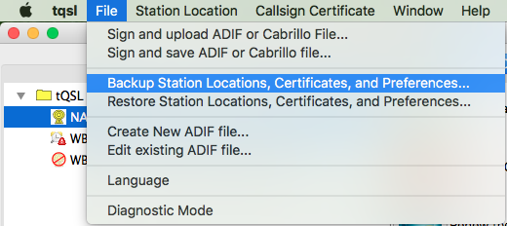
Backup and Restore
File: Backup…

Slide 47
Backup and Restore
You can move your TQSL configuration to other computers regardless of the operating system or platform

Slide 48
Station locations: What if I operate portable?
In addition to placing an electronic signature on your log file, TQSL also adds your geographic information to the Trusted file.
Station locations are associated with your certificate.

Slide 49
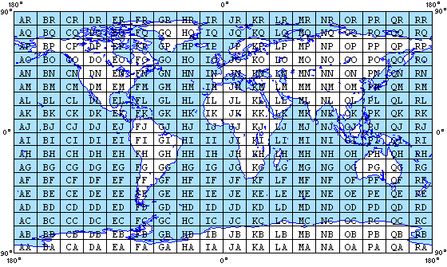
Station locations
Geographic information can include US States, counties, provinces, grid squares, CQ and ITU zones, IOTA, etc.

Slide 50
Station locations
You can make as many station locations as needed to accommodate your operations.
This is great for grid or county activations, or Field Day

Slide 51
Recap
LoTW only accepts Trusted files.
TQSL is the software that creates Trusted files.

Slide 52
Recap
The Call Sign Certificate request and acceptance must be performed from the same computer.
Geographic information is managed through Station Locations.

Slide 53
Recap
TQSL configurations can be moved to another computer using the backup and restore functions.

Slide 54
Using TQSL and LoTW

Slide 55
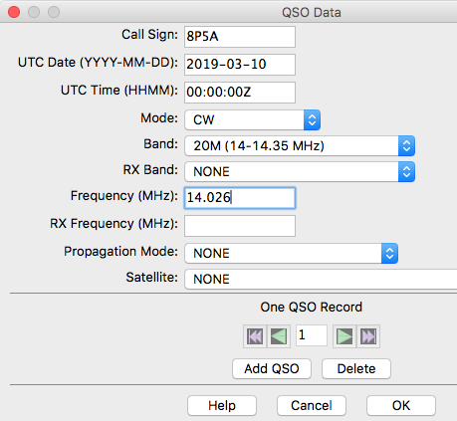
How do I upload QSO data to LoTW?
TQSL does allow you to manually enter QSOs, one at a time…
...But it’s MUCH easier to use a logging application, and let it do most of the work.

Slide 56
Data must be in ADIF files
TQSL requires that your data be in ADIF format
ADIF = Amateur Data Interchange Format
All logging software generates ADIF
<CALL:4>PJ4X <QSO_DATE:8>20170218 <TIME_ON:6>010137 <BAND:3>80M <STATION_CALLSIGN:4>NA6O <FREQ:7>3.52698 <CONTEST_ID:10>ARRL-DX-CW <FREQ_RX:7>3.52698 <MODE:2>CW <RST_RCVD:3>599 <RST_SENT:3>599 <RX_PWR:1>K <OPERATOR:4>NA6O <CQZ:1>9 <STX:1>1 <APP_N1MM_POINTS:1>3 <APP_N1MM_RADIO_NR:1>1 <APP_N1MM_CONTINENT:2>SA <APP_N1MM_RUN1RUN2:1>1 <APP_N1MM_RADIOINTERFACED:1>1 <APP_N1MM_ISORIGINAL:4>True <APP_N1MM_NETBIOSNAME:4>STN1 <APP_N1MM_ISRUNQSO:1>0 <EOR>

Slide 57
What’s in the ADIF file?
Required QSO information is in your ADIF file:
Call sign of station worked
Date
Time
Band
Mode
Geographical info comes from the Station Location

Slide 58
Automate the process
Your Logging
Application
Secure
Upload
Export
Import
ADIF file
Most loggers will automate this for you

Slide 59
Screenshot from Ham Radio Deluxe
LoTW confirmation
(from downloads)
LoTW Upload and Download buttons

Slide 60
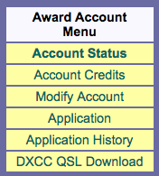
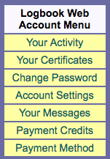
Everything else is thru the LoTW user web page
https://lotw.arrl.org

Slide 61
The only link you need
http://www.arrl.org/logbook-of-the-world

